Slide 1
UNIT 3
POWER FLOW STUDIES

Slide 2
BUS CLASSIFICATION
1.Slack bus or Reference bus or Swing bus:
|V| and δ are specified. P and Q are un specified, and to be calculated.
2.Generator bus or PV bus or Voltage controlled bus:
P and |V| are specified. Q and δ are un specified, and to be calculated
3.Load bus or PQ bus:
P and Q are specified. |V| and δ are un specified, and to be calculated

Slide 3
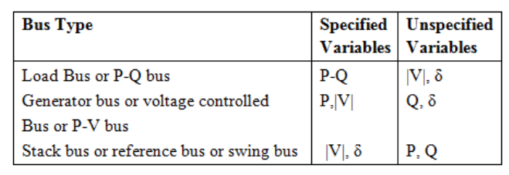
BUS CLASSIFICATION

Slide 4
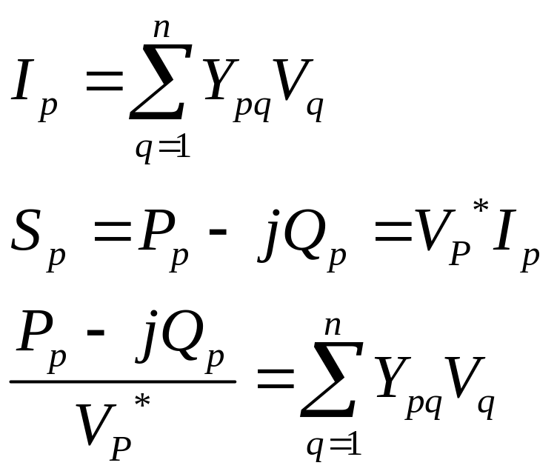
ITERATIVE METHOD
The above Load flow equations are non linear and
can be solved by following iterative methods.
1.Gauss seidal method
2.Newton Raphson method
3.Fast Decoupled method

Slide 5
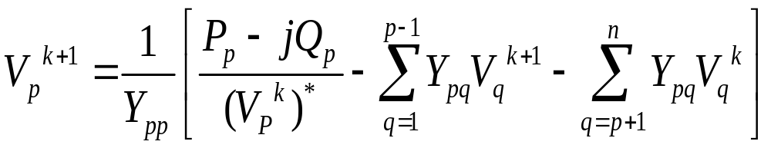
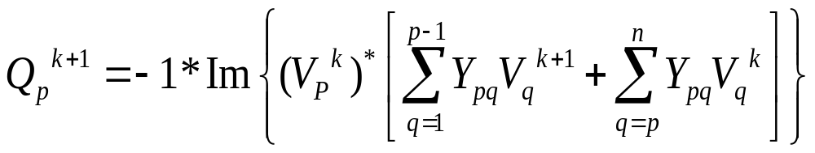
GAUSS SEIDAL METHOD
For load bus calculate |V| and δ from V_{p}^{k+1} equation
For generator bus calculate Q from Q_{P}^{K+1} equation

Slide 6
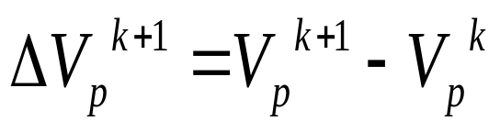
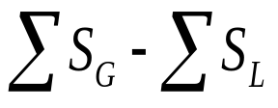
Check Q_{p,cal}^{k+1} with the limits of Q_{p}
If Q_{p,cal}^{k+1} lies within the limits bus p remains as PV bus otherwise it will change to load bus
Calculate δ for PV bus from V_{p}^{k+1} equation
Acceleration factor α can be used for faster convergence
Calculate change in bus-p voltage
If |ΔV_{max} |< ε, find slack bus power otherwise increase the iteration count (k)
Slack bus power=

Slide 7
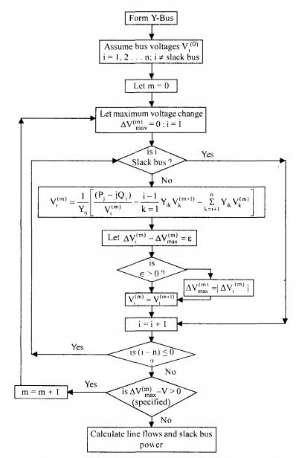
GAUSS SEIDAL METHOD

Slide 8
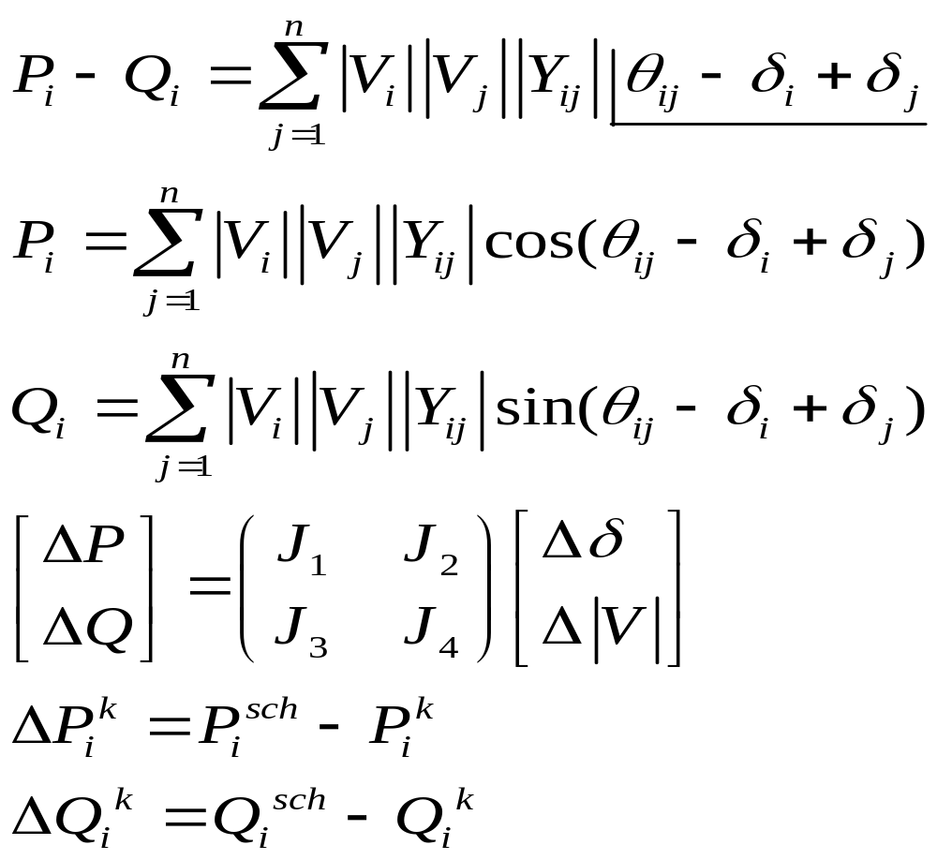
NEWTON RAPHSON METHOD

Slide 9
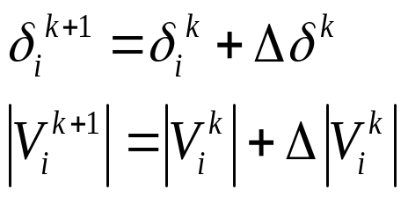
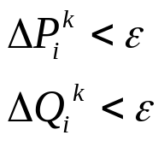
Calculate |V| and δ from the following equation
If
stop the iteration otherwise increase the iteration count (k)

Slide 10
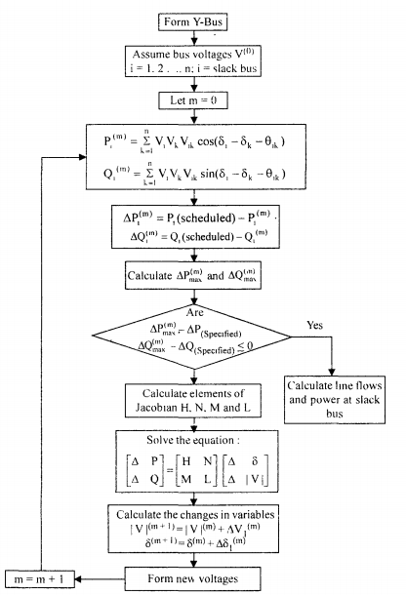

Slide 11
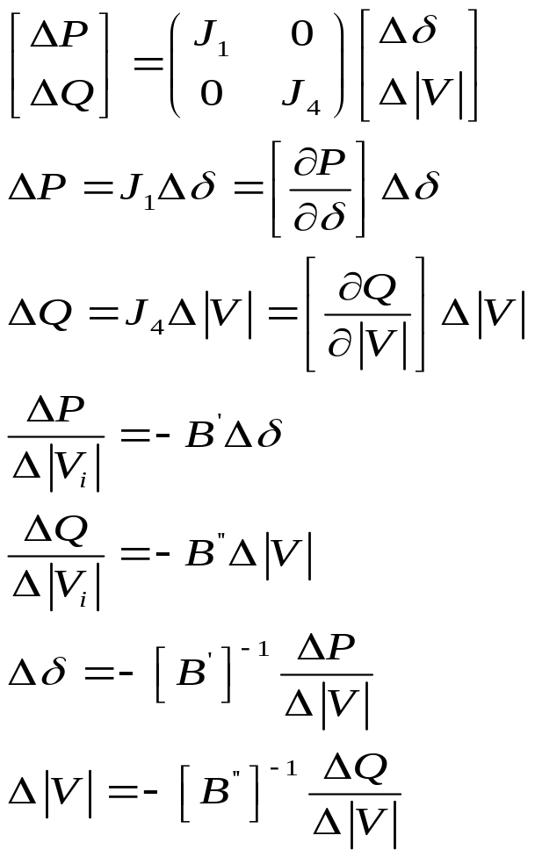
FAST DECOUPLED METHOD
J₂ & J₃ of Jacobian matrix are zero

Slide 12
This method requires more iterations than NR
method but less time per iteration
It is useful for in contingency analysis

Slide 13
COMPARISION BETWEEN ITERATIVE METHODS
Gauss – Seidal Method
Computer memory requirement is less.
Computation time per iteration is less.
It requires less number of arithmetic operations to complete an iteration and ease in programming.
No. of iterations are more for convergence and rate of convergence is slow (linear convergence characteristic.
No. of iterations increases with the increase of no. of buses.

Slide 14
NEWTON – RAPHSON METHOD
Superior convergence because of quadratic convergence.
It has an 1:8 iteration ratio compared to GS method.
More accurate.
Smaller no. of iterations and used for large size systems.
It is faster and no. of iterations is independent of the no. of buses.
Technique is difficult and calculations involved in each iteration are more and thus computation time per iteration is large.
Computer memory requirement is large, as the elements of jacobian matrix are to be computed in each iteration.
Programming logic is more complex.

Slide 15
FAST DECOUPLED METHOD
It is simple and computationally efficient.
Storage of jacobian matrix elements are60% of NR method
computation time per iteration is less.
Convergence is geometric, 2 to 5 iterations required for accurate solutions
Speed for iterations is 5 times that of NR method and 2-3 times of GS method.

